Slide 2

ONLINE FEEDBACK FORM
August 24, 2024

Slide 3
Agenda
Objective
Problem Statement
Software Development Life Cycle (SDLC): Introduction
Planning & Requirement Gathering
Defining
Design
Development
Testing
Deployment & Maintenance
Jira

Slide 4
OBJECTIVE
Value of User Insights:
Gather actionable insights to improve services and make informed decisions based on user opinions.
Streamline Feedback Collection:
Provide an easy-to-use form for users to submit their feedback efficiently.
Ensure Data Accuracy:
Implement form validations to capture and store feedback accurately.
Confirm Submission and Acknowledge Users:
Redirect users to a confirmation page and display a thank-you message.

Slide 5
The goal is to extend the Node.js feedback form application to interact with a database server. The system will need to: Store and Retrieve Data: The database and Form will have store and take the following feedback details: Rating on Faculty Punctuality: (1 to 5) Rating on Doubts Clarification: (1 to 5) Rating on Topics Explanation: (1 to 5) Rating on Communication Skills: (1 to 5) Rating on Overall Feedback: (1 to 5) Other Reasons: Free text for additional comments or reasons
Problem Statement

Slide 6
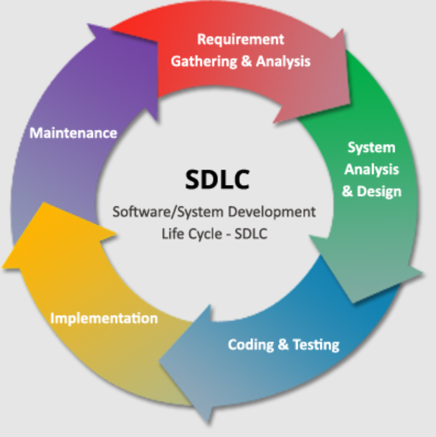
Software Development Life Cycle (SDLC):
The Software Development Life Cycle (SDLC) offers a structured framework that ensures thorough planning, execution, and management of software projects
It provides a clear roadmap through each phase, from initial planning to deployment and maintenance, ensuring a systematic approach to developing a reliable and efficient form.

Slide 7
Requirement Gathering

Slide 8
Functional Requirements
Include fields for ratings on various
Store feedback in a database with fields for each rating, comments, and an auto-generated ID.
Ensure that form data is submitted to the backend server
Non-Functional Requirements
The system should handle multiple simultaneous submissions..
The system should be able to scale with an increasing amount of feedback data.
The user interface should be intuitive and easy to use.

Slide 9
DESIGN

Slide 10
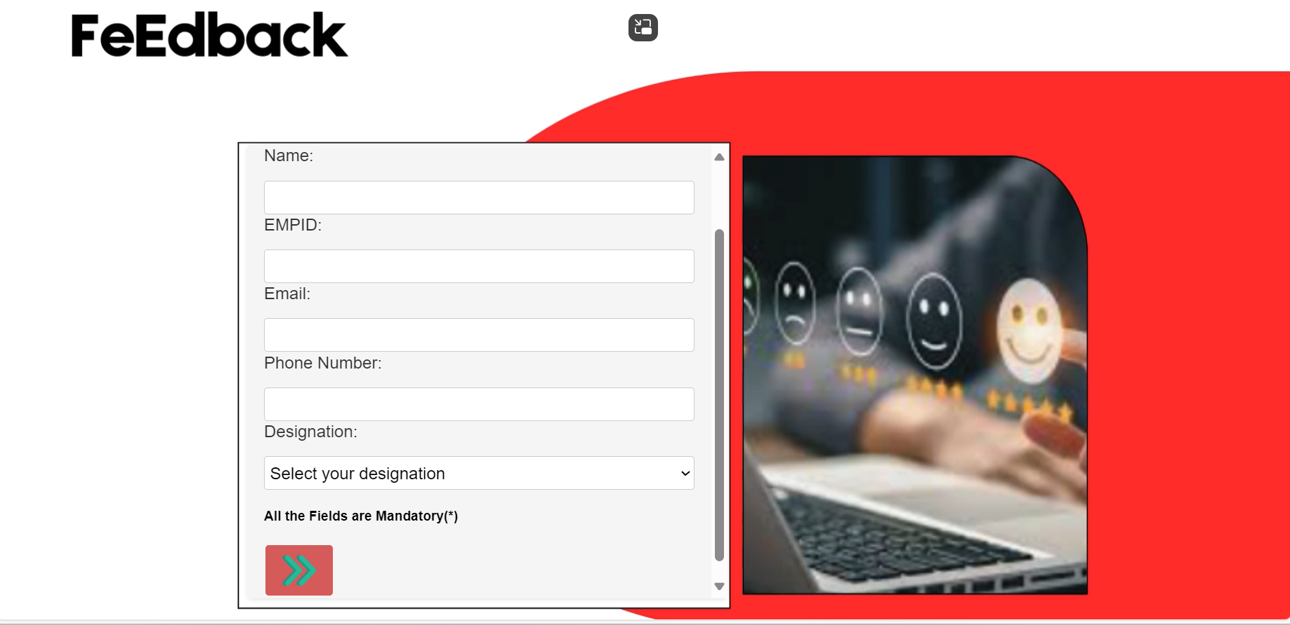
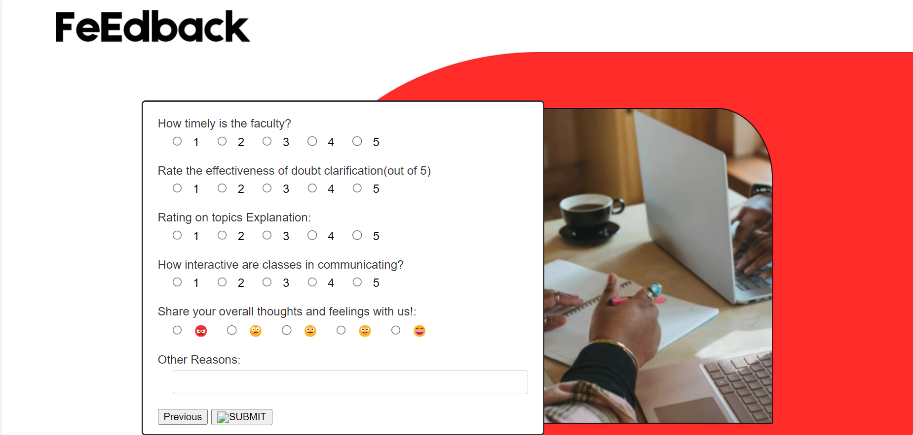
UI/UX Design:
Home Page
Feedback Page
Designed wireframes and mockups for user interface.
Ensured ease of use and clear navigation paths.

Slide 11
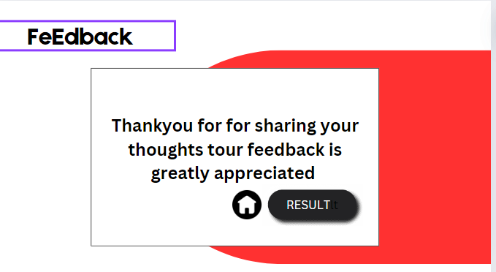
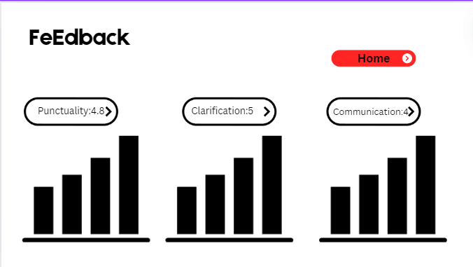
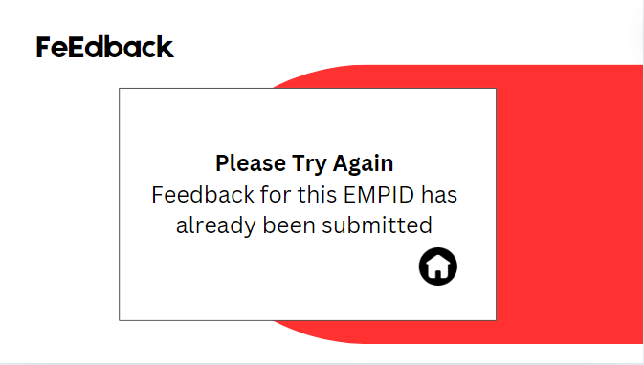
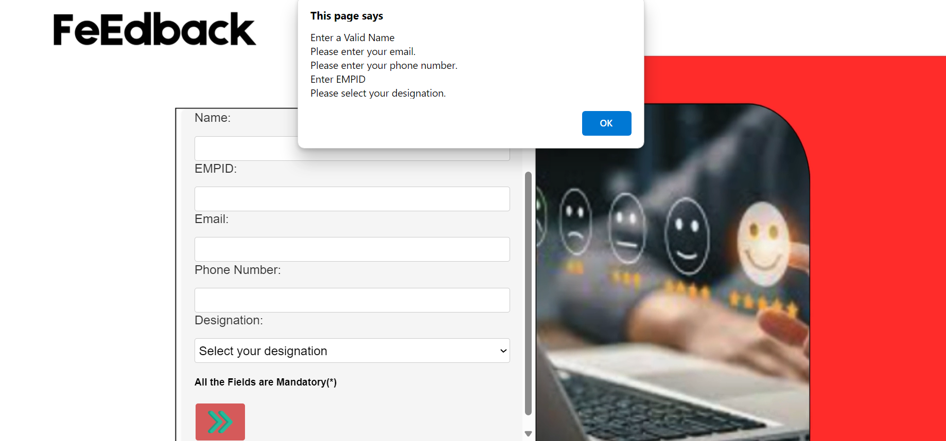
Thankyou Page
Result Page
Error Pages

Slide 12
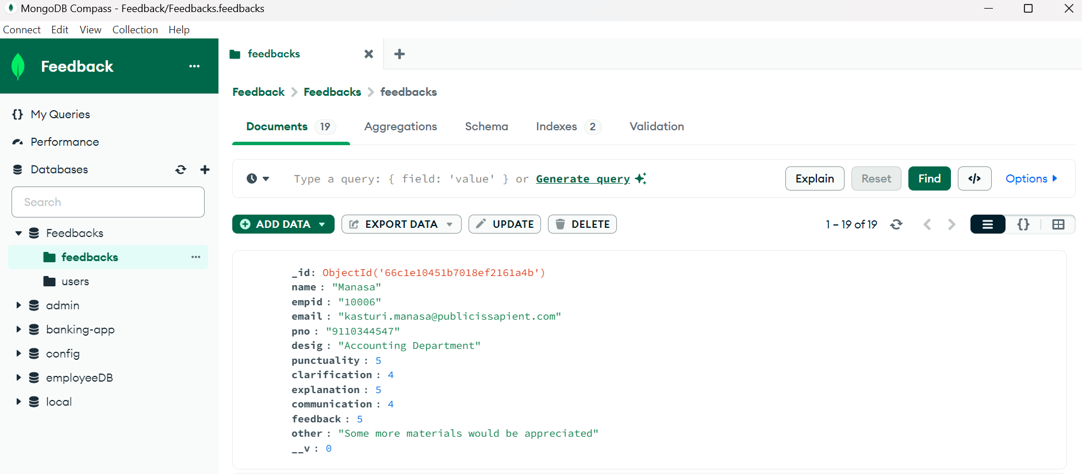
Database Design and Integration(MongoDB)
Schema Design:
const feedbackSchema = new mongoose.Schema({
name: String,
empid: { type: String, unique: true },
email: String,
pno: String,
desig: String,
punctuality: Number,
clarification: Number,
explanation: Number,
communication: Number,
feedback: Number,
other: String
});
Fields:
Personal Information
Feedback Ratings
Additional Comments

Slide 13
Development

Slide 14
IMPLEMENTATION
Frontend Development:
Implement HTML/CSS for form and results page design.
Develop JavaScript for client-side form validation and chart rendering.
Backend Development:
Set up Node.js server with Express for handling requests.
Connect to MongoDB for storing and retrieving feedback data.
Implement API endpoints for form submission and statistics retrieval.

Slide 15
HTML & CSS Files
Index.html - Contains the form for collecting user feedback.
feedback2.html - Second part of the feedback form with additional questions.
Thankyou.html-This page is displayed to the user after they successfully submit their feedback form, thanking them for their input.
Error.html-This page is shown when there is an error with the feedback submission, such as if the feedback is a duplicate or there was a server issue.
results.html - Displays feedback results in chart form.
server.js - Server-side logic for handling form submissions and interacting with the database.
Style.css-

Slide 16
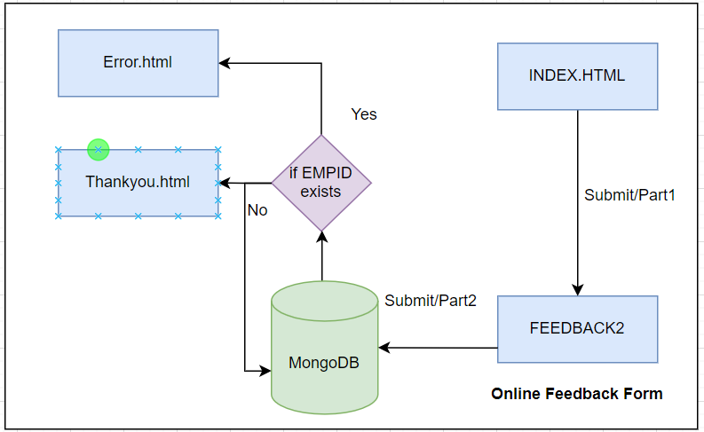
Workflow of Feedback Form System
Users submit feedback through an HTML form, which is then sent to the server and stored in the database.

Slide 17
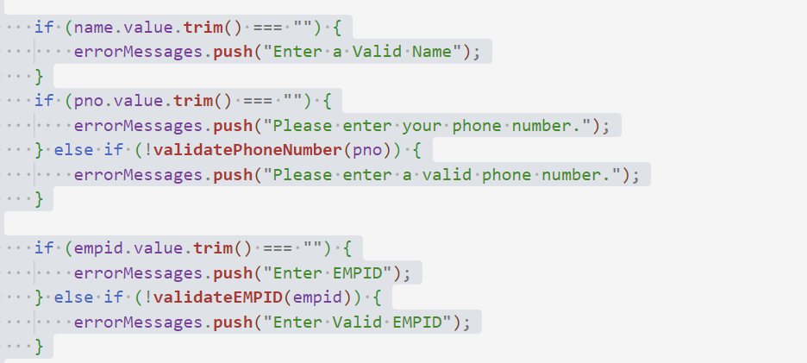
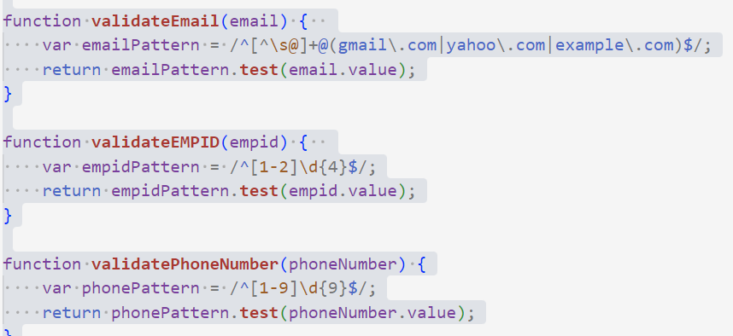
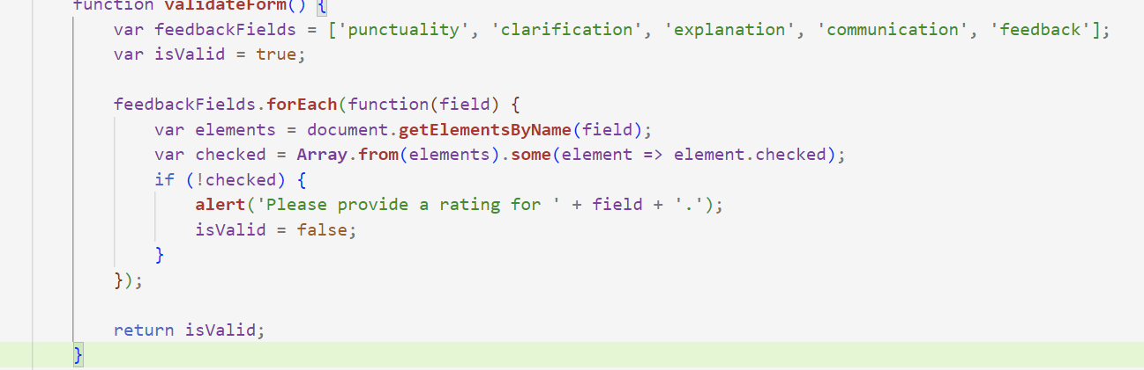
Form Validations
Index.html
Feedback2.html

Slide 18
Server-Side Implementation
Submit-part1
Submit-part2
app.post('/submit-part2', async (req, res) => {
const formData = req.session.formData || {};
console.log('Form Data:', req.body);
const feedbackData = new Feedback({
...formData,
punctuality: parseInt(req.body.punctuality, 10),
clarification: parseInt(req.body.clarification, 10),
explanation: parseInt(req.body.explanation, 10),
communication: parseInt(req.body.communication, 10),
feedback: parseInt(req.body.feedback, 10),
other: req.body.other || '' });
try {
const existingFeedback = await Feedback.findOne({ empid: formData.empid });
if (existingFeedback) {
req.session.destroy();
return res.redirect('/error.html');
}
await feedbackData.save();
req.session.destroy();
res.redirect('/thankyou.html');
} catch (err) {
console.error('Error saving feedback:', err);
res.status(500).json({ success: false, message: 'Internal Server Error' });}
});
app.post('/submit-part1', (req, res) => {
req.session.formData = {
name: req.body.name,
empid: req.body.empid,
email: req.body.email,
pno: req.body.pno,
desig: req.body.desig};
res.redirect('/feedback2.html');
});

Slide 19
Server Setup
const express = require('express');
const app = express();
const port = 3000;
app.listen(port, () => {
console.log(`Server running on http://localhost:${port}`);
});
Database Aggregation (server.js):
app.get('/api/feedback-stats', async (req, res) => {
try {
const feedbackData = await Feedback.aggregate([
{ $group: { _id: null, punctuality: { $push: "$punctuality" }, clarification: { $push: "$clarification" }, explanation: { $push: "$explanation" }, communication: { $push: "$communication" }, feedback: { $push: "$feedback" } } }]);
if (feedbackData.length > 0) {
const data = feedbackData[0];
res.json({
punctuality: countRatings(data.punctuality),
clarification: countRatings(data.clarification),
explanation: countRatings(data.explanation),
communication: countRatings(data.communication),
feedback: countRatings(data.feedback)});
} else {
res.json({});}
} catch (err) {
console.error('Error fetching feedback stats:', err);
res.status(500).json({ success: false, message: 'Internal Server Error' });}});

Slide 20
Testing

Slide 21
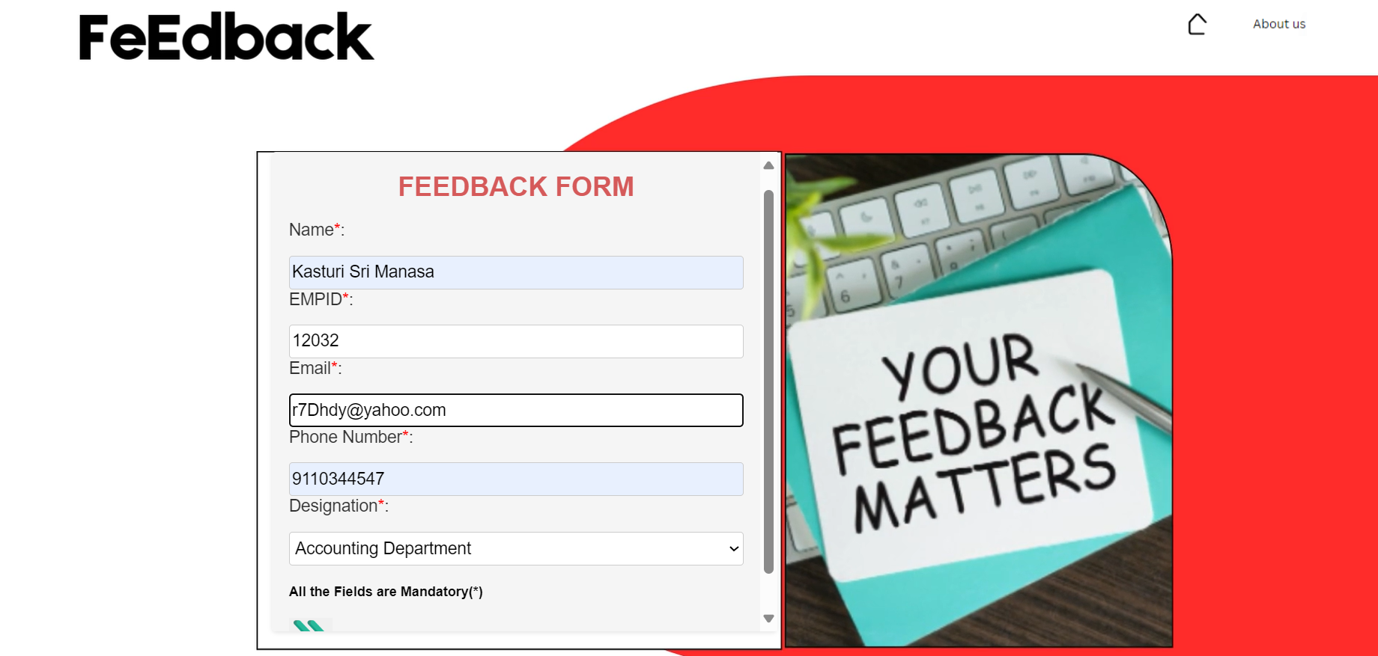
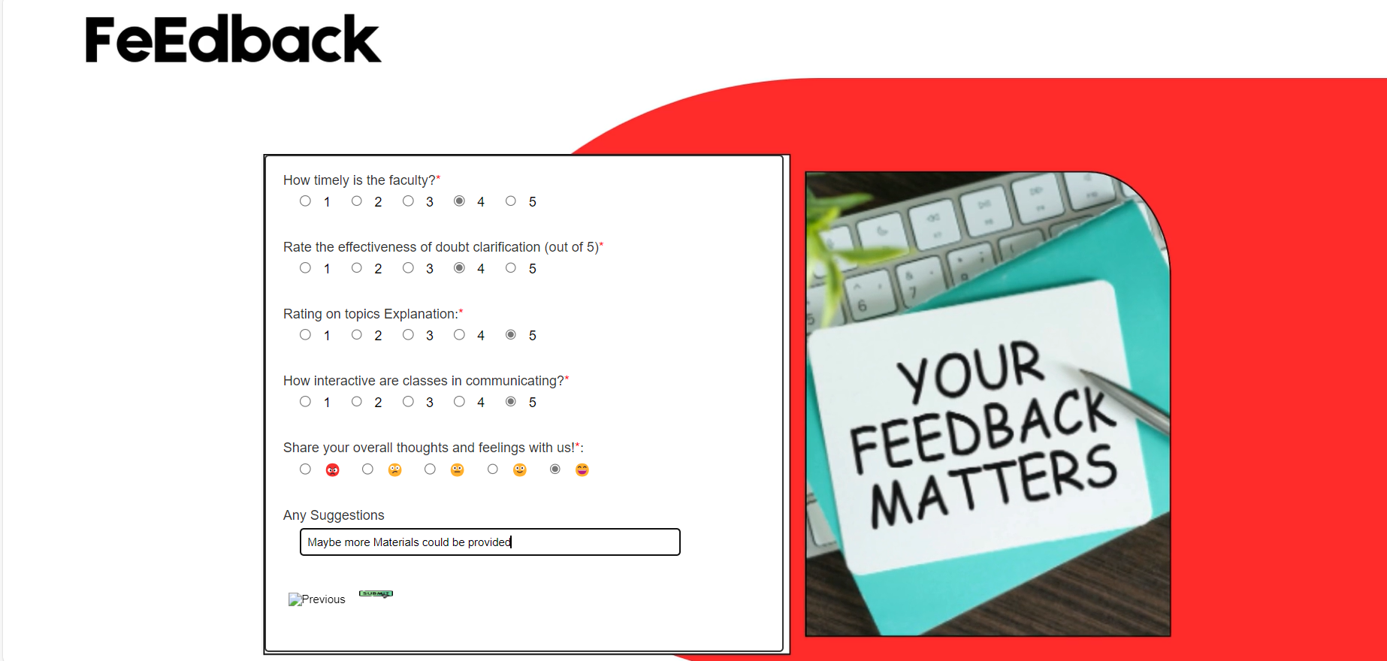
Test Case 1 - Form Submission
Open the feedback form page.
Fill in all required fields with valid data:
Name, Employee ID, Phone Number, Email Address , Designation
Feedback Rating
Click the submit button

Slide 22
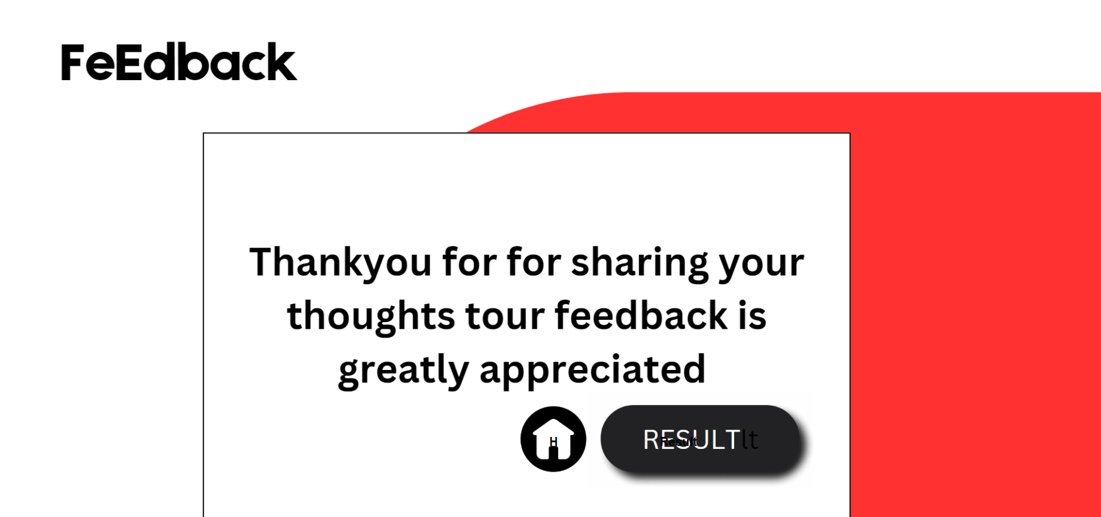
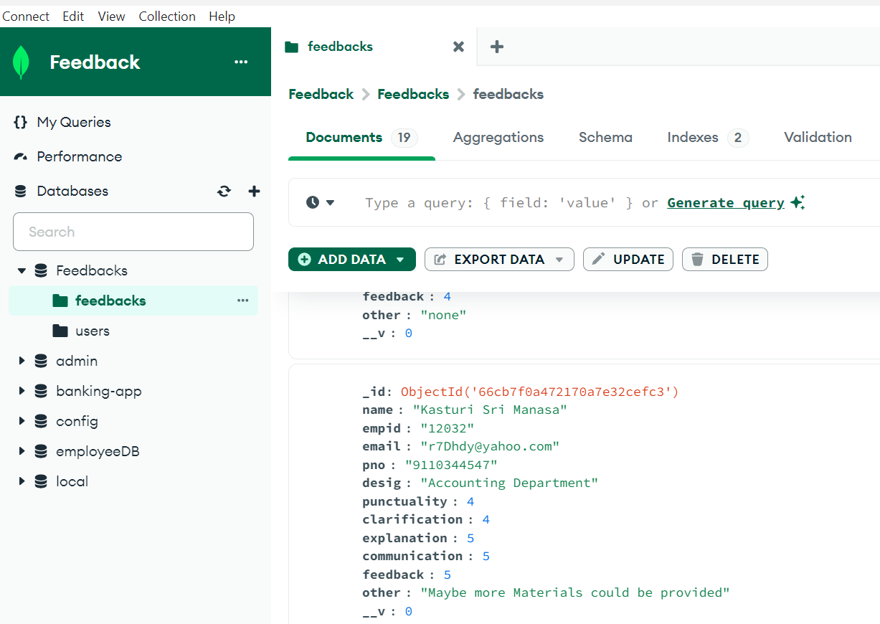
Outcome
Expected Result | Outcome - Success
Home Page -The form should be successfully submitted. | The form is submitted, the user is redirected to thankyou.html. The values got successfully stored in Feedback database

Slide 23
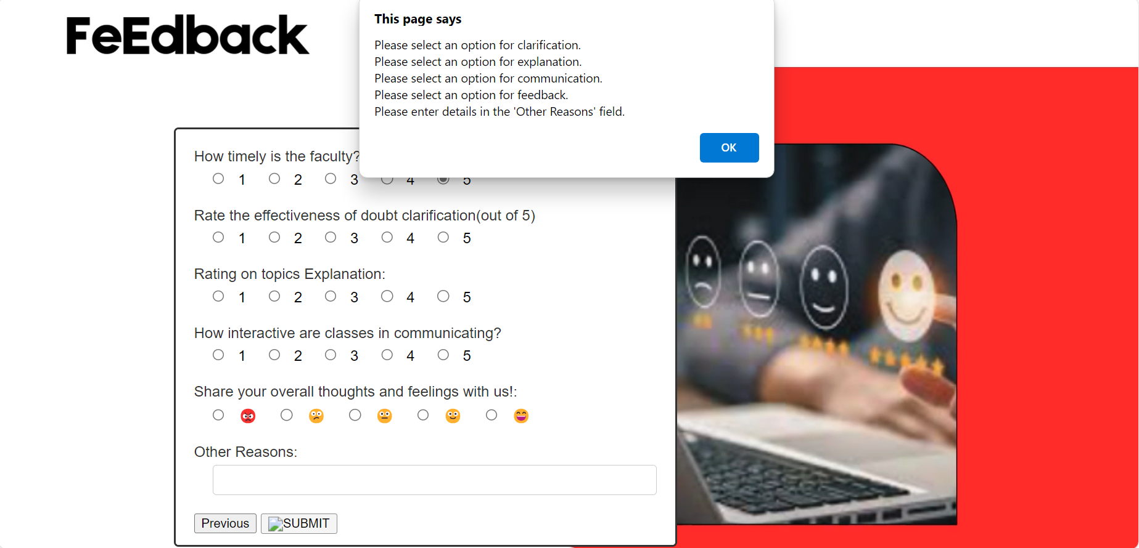
Test Case 2 - Form Validation
Expected Result | Outcome - Success
Validation: The form should not be submitted if there are Empty fields An error message indicating which fields are required should be displayed on the form page. | An error message is displayed indicating which fields need to be filled in (e.g., "Employee ID is required" or "Feedback cannot be empty"), and the form is not submitted.

Slide 24
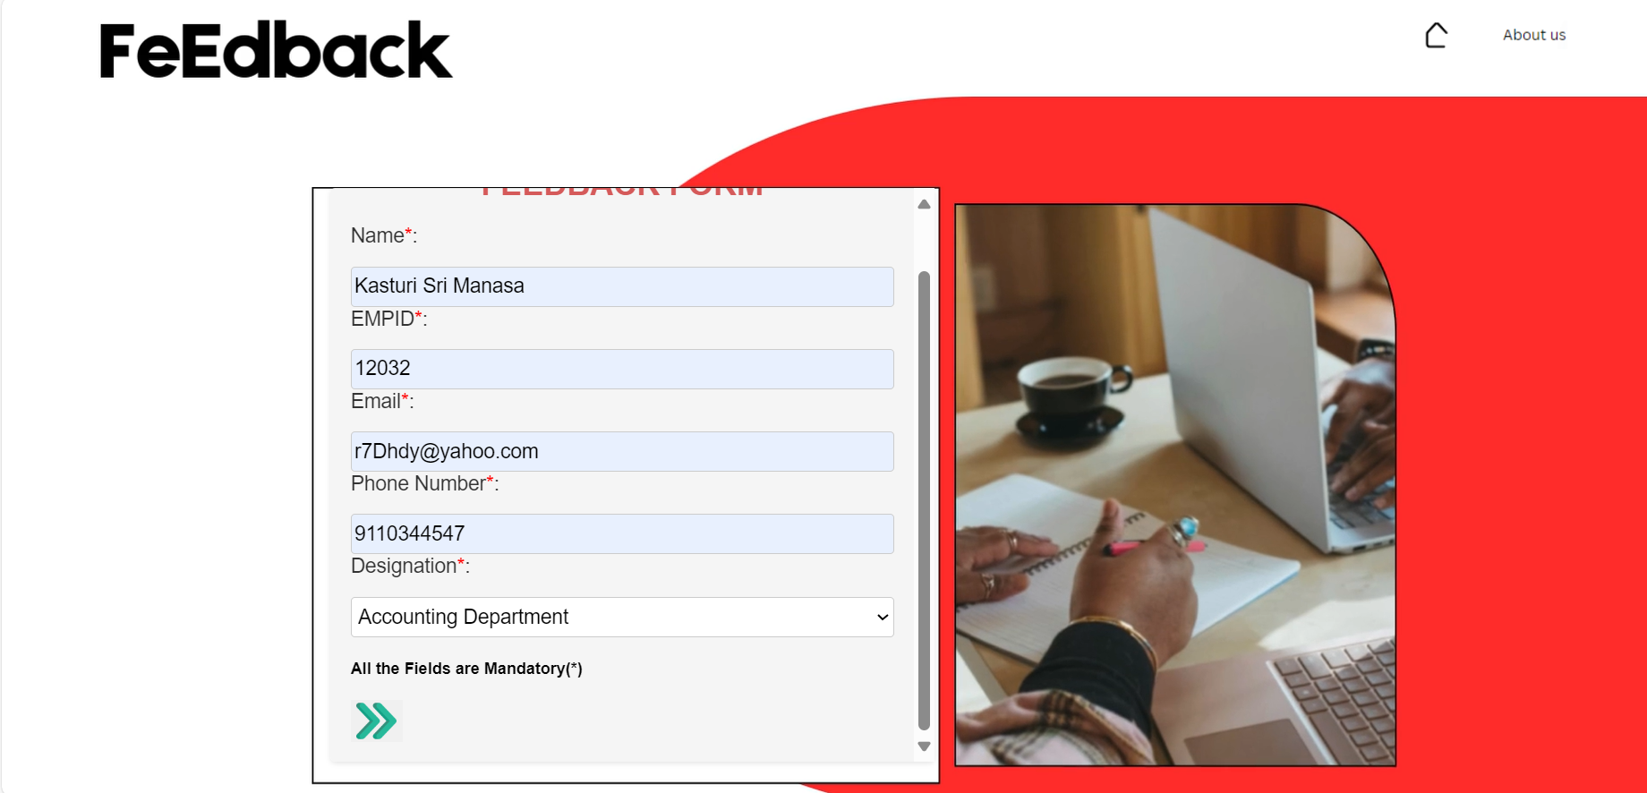
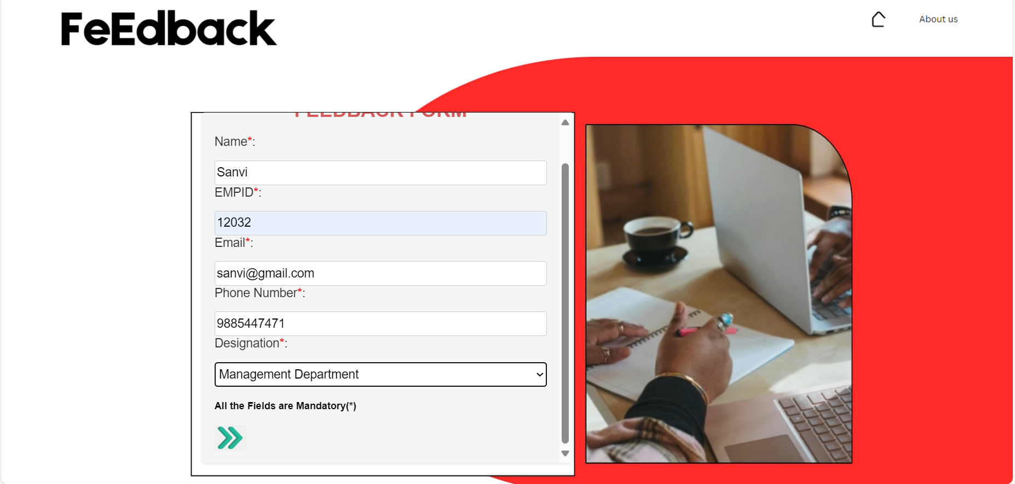
Test Case 3 - Duplicate Employee ID
Open the feedback form page.
Enter an employee ID that has already been used to submit feedback.
Fill in the feedback field and submit the form.

Slide 25
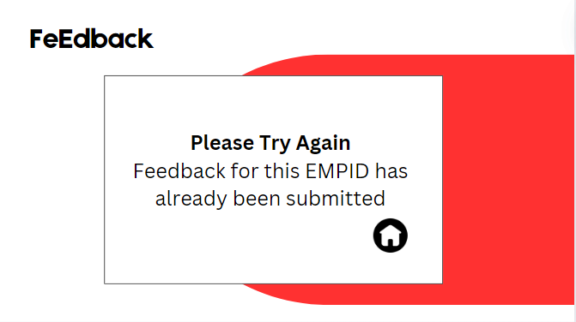
Outcome
Expected Result | Outcome
- If duplicates are allowed: Feedback should be successfully submitted, and the user should be redirected to thankyou.html. - If duplicates are not allowed: An error message indicating that feedback for this employee ID already exists should be displayed, and the form should not be submitted | -The form is submitted, and the user is redirected to thankyou.html, with the feedback stored for the duplicate ID. -An error message is shown (e.g., "Feedback for this Employee ID already exists"), and the form is not submitted.

Slide 26
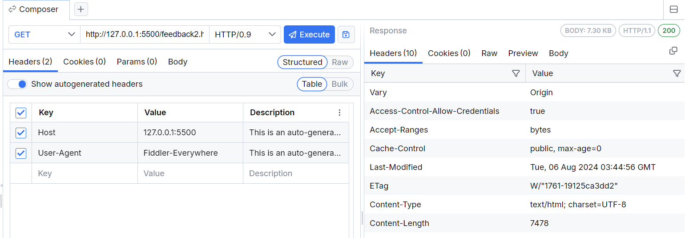
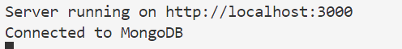
Deployment
Maintenance
Performance Monitoring: Track the website’s performance metrics (e.g., load times, response times).
User Feedback: Collect and review feedback from users to identify potential improvements or issues.
Code Deployment: Transfer the feedback form code to the server.
Launch: Make the website live for end-users.

Slide 27
JIRA

Slide 28
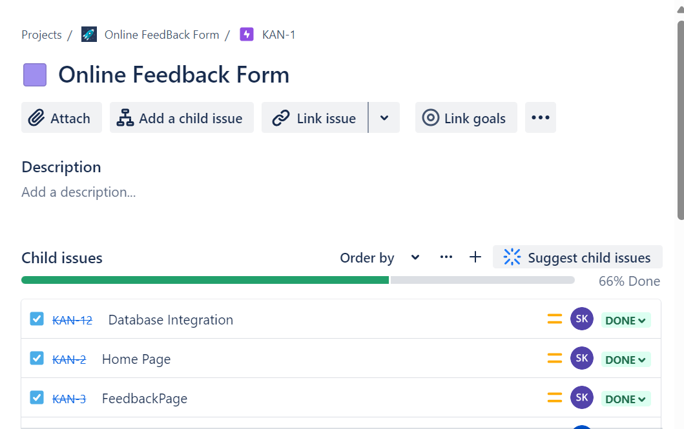
Kanban Board for Feedback Form Project
Large, high-level features or goals for the project.
Assigned to team members or groups responsible for delivering major parts of the project.
Epics:

Slide 29
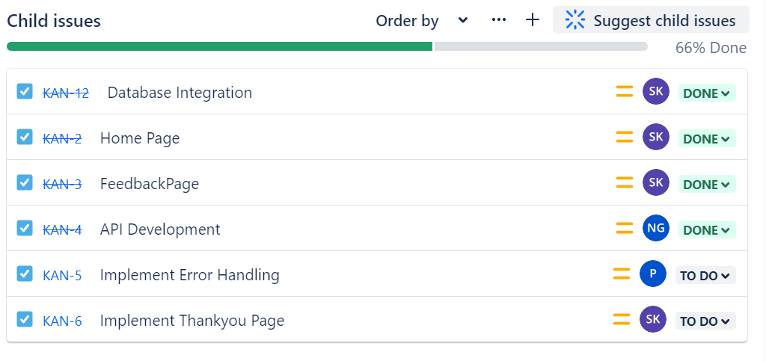
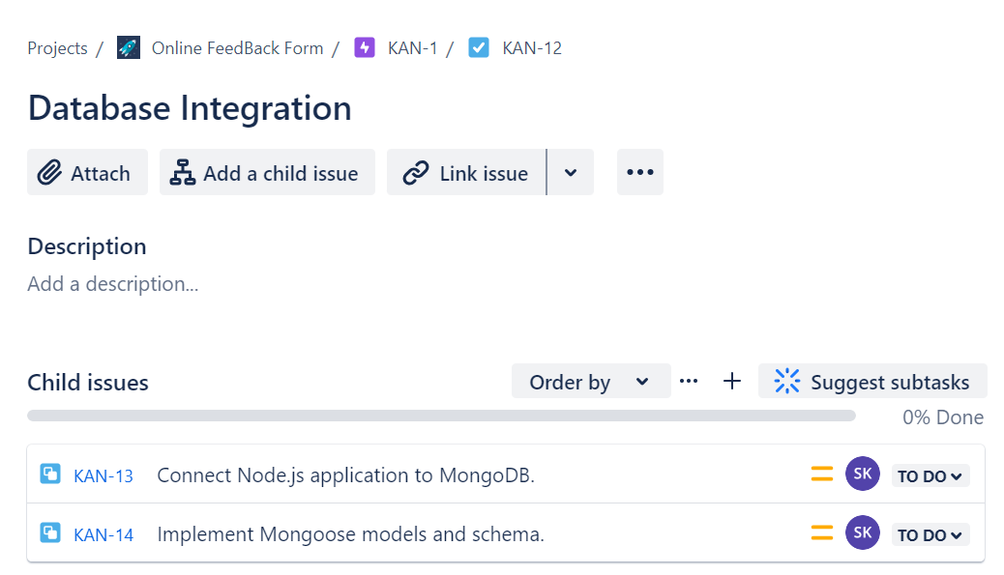
Tasks: Specific actions required to complete epics.
Subtasks: Breakdown of tasks into smaller, actionable items

Slide 30
thank you
copyright publicis sapient | confidential

